Slide 1
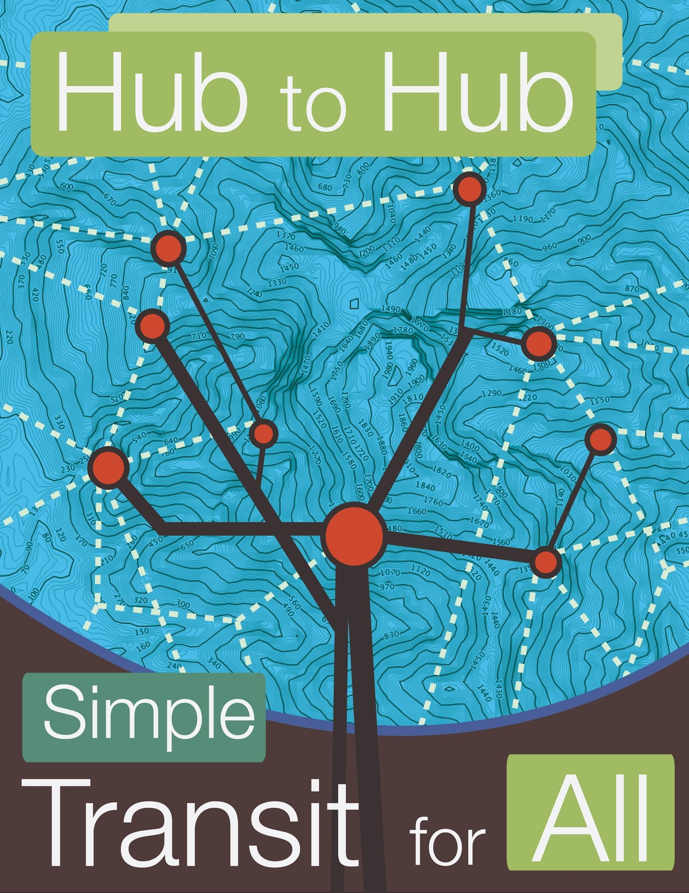
Baltimore Green Forum
Electric Vehicles (EVs) and EV-Ready Transit Hubs
By
Jill Sorensen
BEVI
Baltimore-Washington Electric Vehicle Initiative
22 November 2015
Maryland Presbysterian Church
1105 Providence Road
Towson, MD 21286

Slide 2
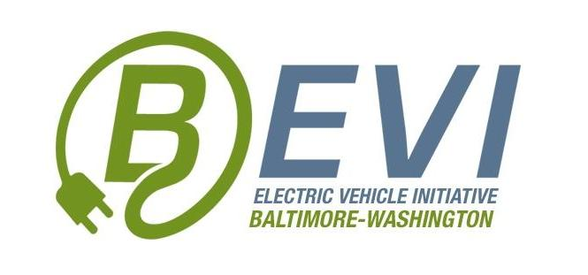
EVs present multiple tiers of opportunity
EVs as clean transportation, reduce emissions, climate benefit
EVs as mobile power management resources
EVs as carbon credit purchase agreements
EV charging as grid stabilization (smart grid, microgrid, auxiliary grid)
EV Readiness - clean transportation as a matter of economic, environmental and national security
3D printed product design, prototyping, testing
2
Notes:
03/28/10
2

Slide 3



Why care about climate change?
Pain from burn
Coal-burning power plants are the largest U.S. source of carbon dioxide pollution -- they produce 2.5 billion tons every year.
Automobiles, the second largest source, create nearly 1.5 billion tons of CO2 annually.
Built architecture. 63% of our energy consumption is from HVAC and lighting, 40% of emissions is from built architecture.
See Natural Resources
Defense Council, www.nrdc.org,
Notes:
319 M people, 270M cars!

Slide 4
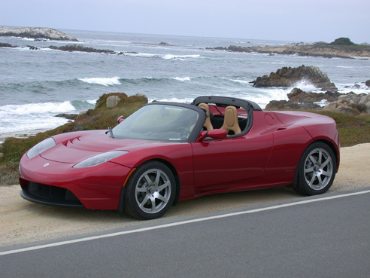
Pleasure: EVs are sporty, fun to drive, cheaper to re-fuel than gas
Notes:
See “Electric Cars 2015 – Prices, Efficiency, Range, Pics, More” by Zach with EV Obsession, February 16, 2014. http://evobsession.com/electric-cars-2014-list/

Slide 5

EVs cool the planet by reducing polluting and heating emissions, advance triple bottom line.
http://nooruddins.com/wp-content/uploads/2010/08/triplebottomline.jpg

Slide 6
Maryland is recognized as one of the top States* for EVs. How did we get this far? Collaboration
Maryland Electric Vehicle Infrastructure Council (MDOT, MEA, MDE, utilities, BEVI, GM, fleet managers, EV charging station manufacturers, local government)
www.marylandEV.org
Transportation and Climate Initiative
Northeast Electric Vehicle Network
U.S. Department of Energy Clean Cities program
ZEV MOU and 8 State participation
CSE2
Plug-In America
Sierra Club
Natural Resources Defense Council
Notes:
* http://www.ucsusa.org/clean-vehicles/electric-vehicles/emissions-and-charging-costs-electric-cars#.VlBxqWSrQlI

Slide 7
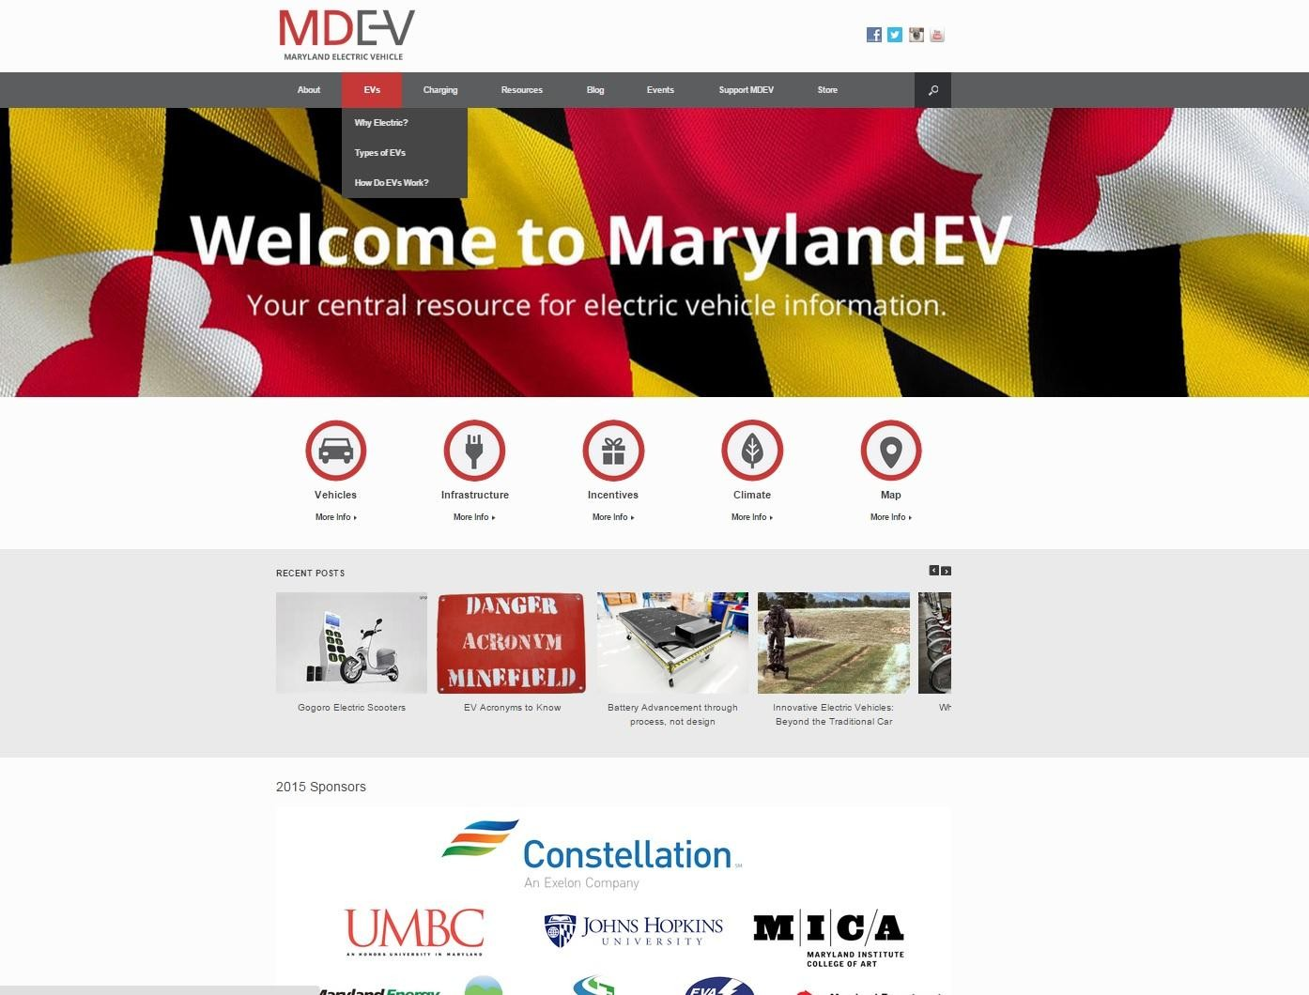
http://marylandev.org/
MDEV

Slide 8
Electric Car Reviews
Audi A3 e-tron
BMW i3
BMW i3 vs Nissan Leaf vs Chevy Volt
BMW i3 vs Tesla Model S
BMW i8
Cadillac ELR
Mitsubishi Outlander PHEV
Nissan Leaf 1st
Nissan Leaf Long-Term
Porsche Panamera S E-Hybrid
Renault Twizy
Renault Zoe
Tesla Model S 70D
Tesla Model S P85D
VW e-Up!
Notes:
See “http://evobsession.com/electric-car-charging-101-types-of-charging-apps-more/” for detailed information on car-charging

Slide 9
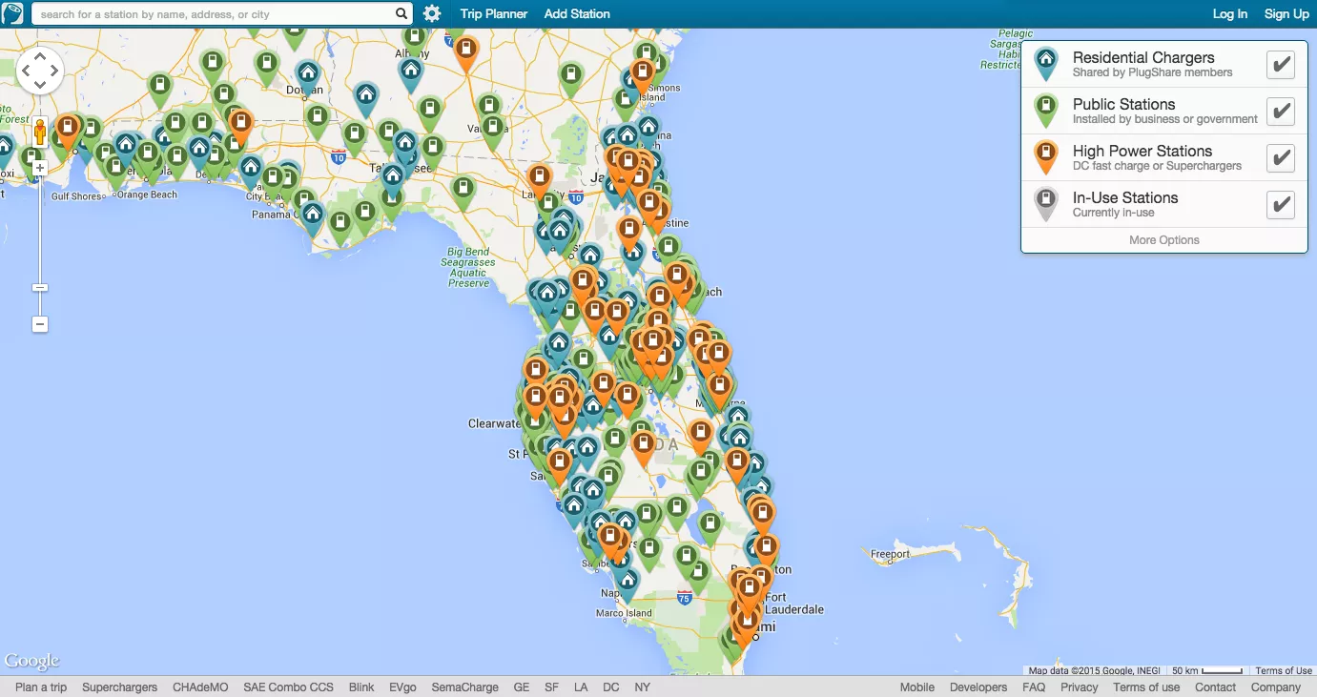
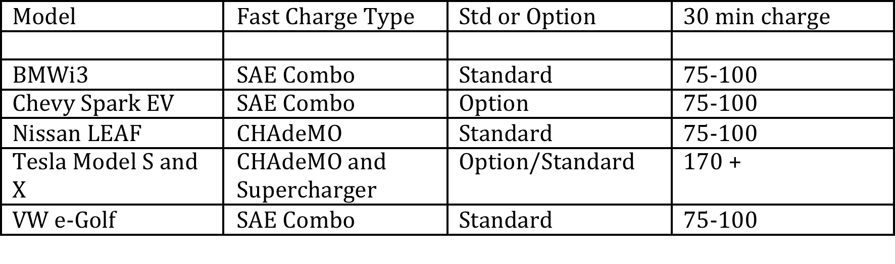
Notes:
See “www.plugshare.com” and “http://www.afdc.energy.gov/fuels/electricity_stations.html” for information on EV charging station locations.

Slide 10
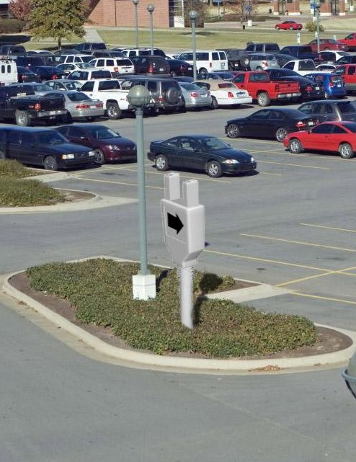
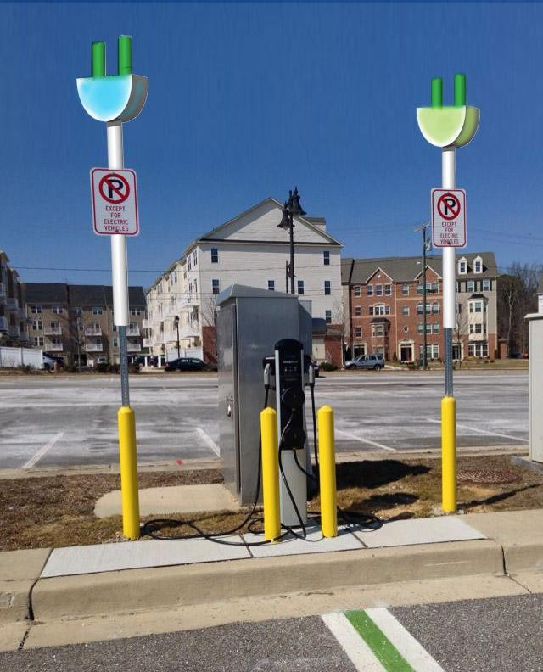
NEED EVSE WAYFINDING

Slide 11
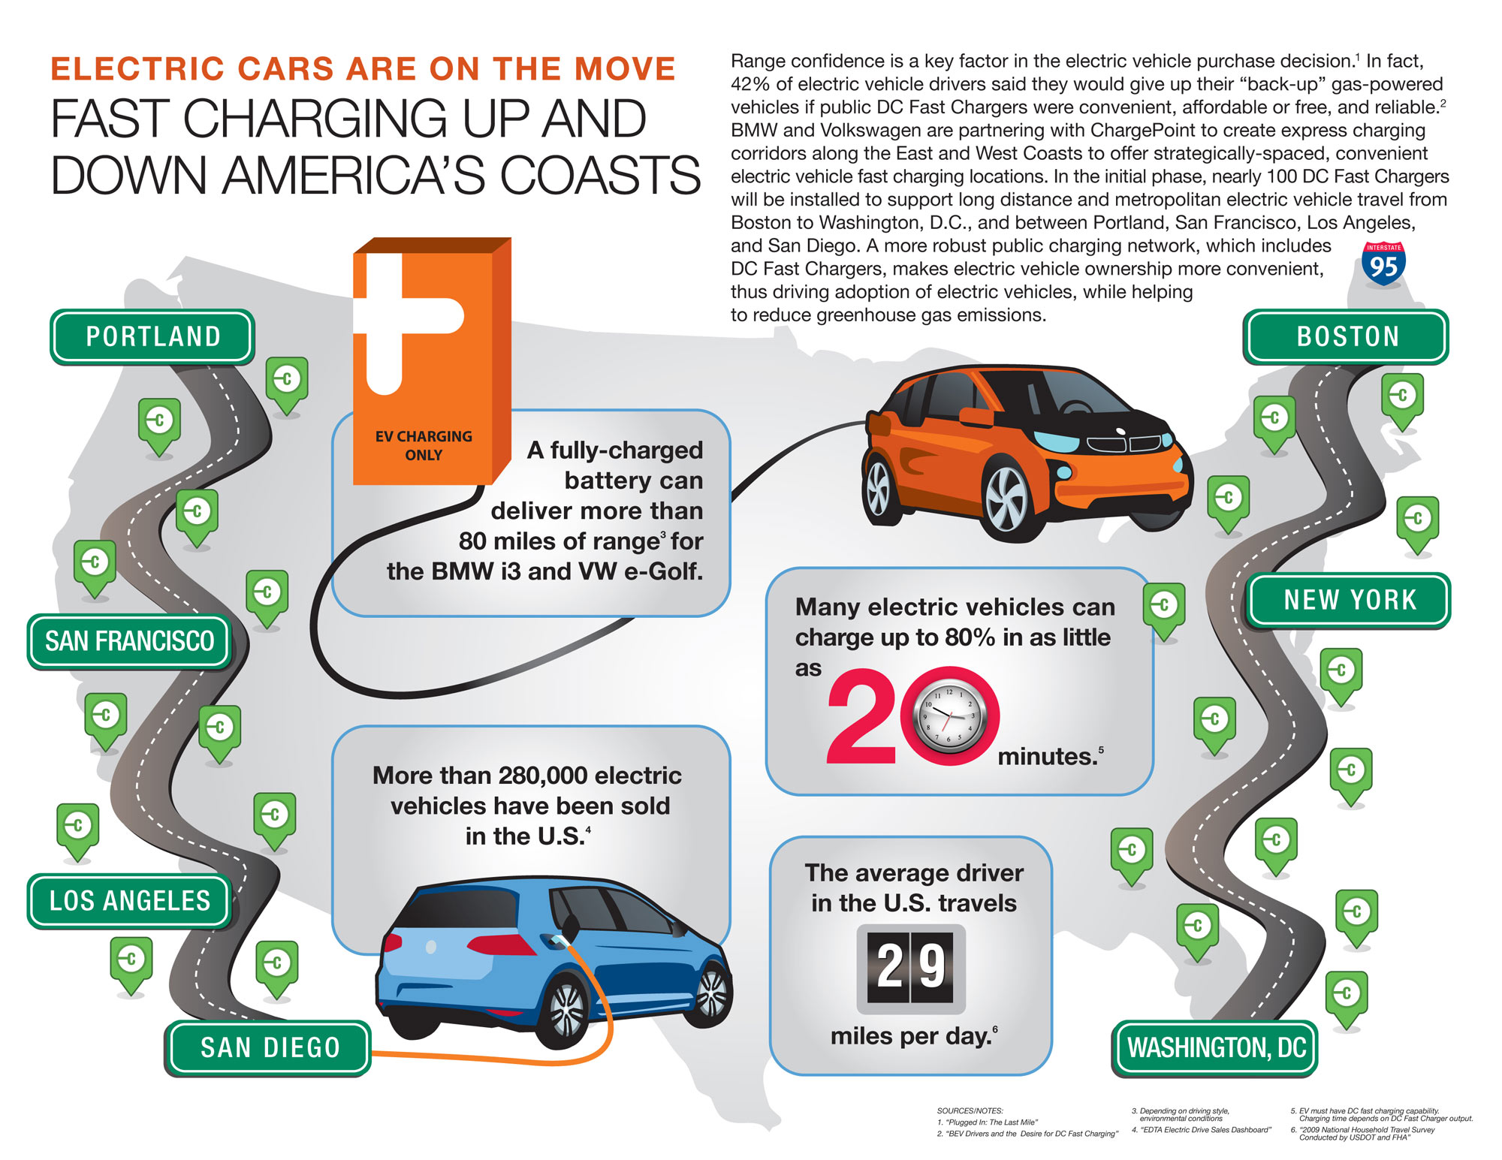

Slide 12
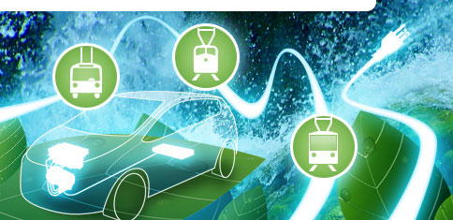
But there is much more to electrifying transportation than cars! Let’s reduce congestion and use more transit.
Image courtesy hydroquebec.com
Notes:
316M people in U.S., 270M

Slide 13
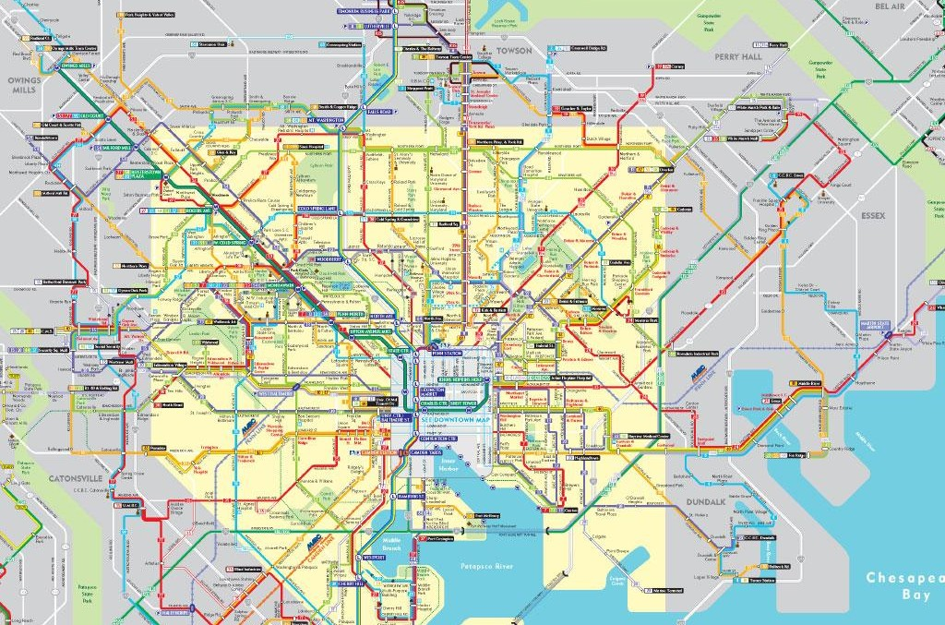
Transit Gaps and Challenges Inhibit Investment
Notes:
Maryland Transit Administration 2014 transit map of Baltimore City.

Slide 18
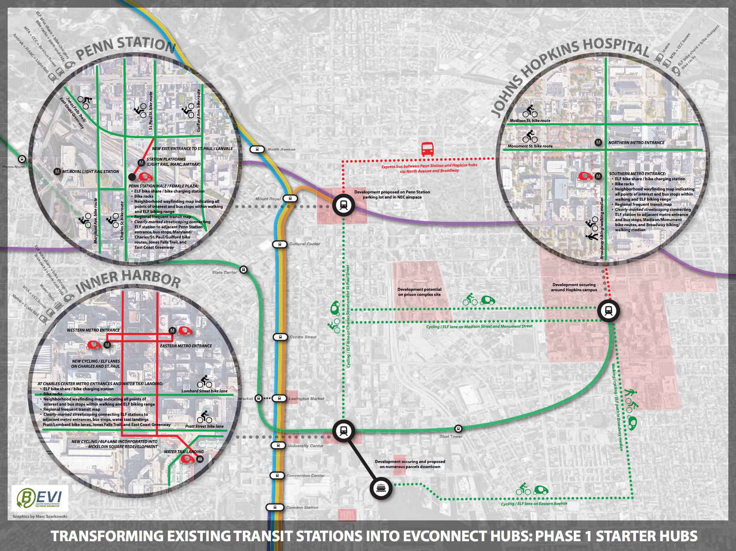
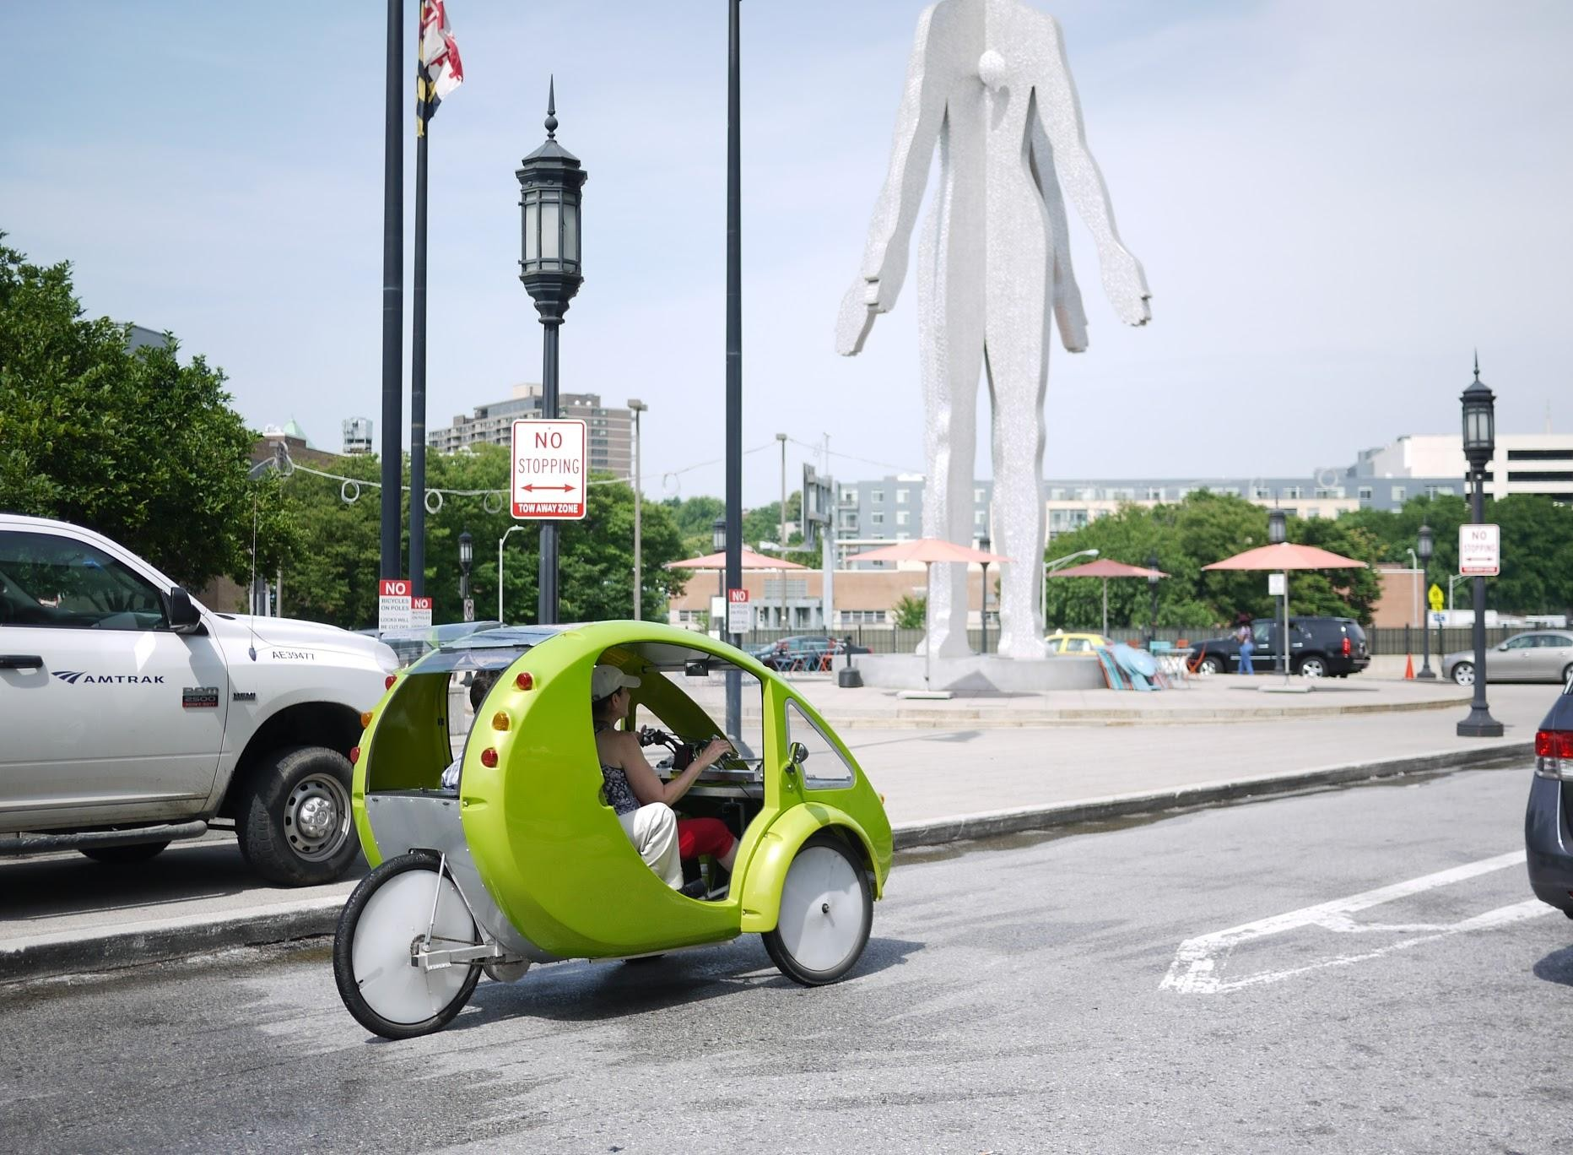

Slide 19

EV-Ready Transit Hubs = Smart City
Each Hub is defined by key features:
Multi-modal, with car-sharing
and bike-sharing
Greenway (Transit way) connections
for active transportation (biking and walking),
electric vehicles (zero emission) and
bus rapid transit (BRT) from Hub to Hub
More than Transit; Hubs are also
Community spaces to promote local artists,
innovation, small businesses and
entrepreneurship (i.e., ArtStart)
Microgrids; clean energy independence
Public wifi; broadband

Slide 20

CONNECTIN G G R E E N W A Y S

Slide 21
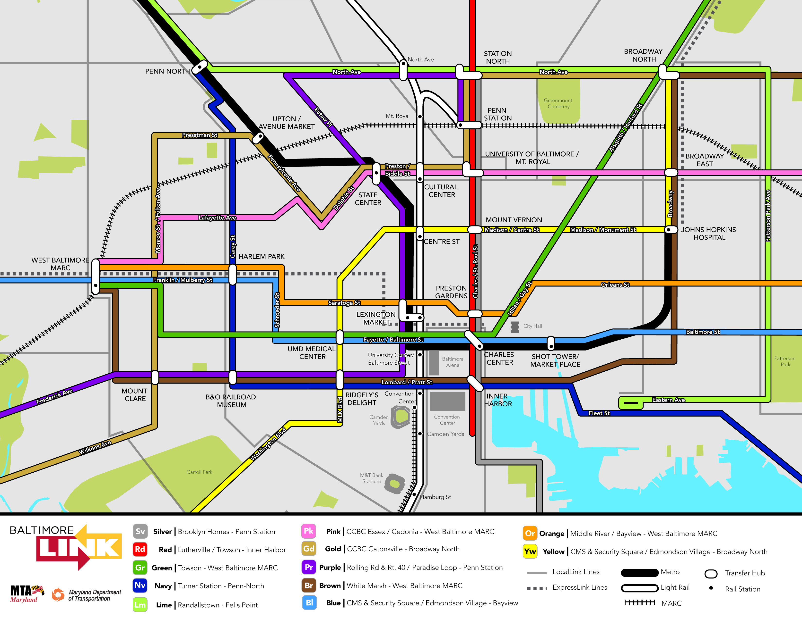
BaltimoreLink
Notes:
http://mta.maryland.gov/citylink-map

Slide 22
Vision of our Energy Future (Rifkin)
1st Pillar - Expanded generation and use of renewable energy
(Wind, solar, biomass, geothermal and wave power are key)
2nd Pillar - Buildings as power plants
- Shifting from centralized power generation and distribution
- Buildings will become "prosumers' - producing consumers
- Homes, schools, offices and factories will become part of a network of
renewable power plants
- Converting all buildings to produce power through solar, wind and other
renewable forms of energy
3rd Pillar - Energy Storage (secondary market for EV batteries, fuel cells, NiMH, hydrogen)
4th Pillar - Development of the Inter-Grid
5th Pillar - EVs: clean, zero emission transportation using electricity and renewablesclean electrons
Notes:
Jeremy Rifkin – The Third Industrial Revolution. http://www.thethirdindustrialrevolution.com/

Slide 23
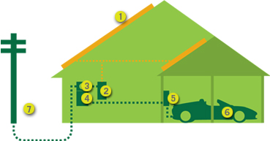
New energy model is localized, with homes as “Micro Power Plants”
Solar Power converts sunlight into direct current (DC)
Inverter converts direct current to alternating current (AC)
AC power travels from inverter to electrical panel (breaker box)
Utility meter continually measures your electrical supply; spins back-
ward if you have more power than you
need (energy credit)
EV charging station re-charges your EV
http://www.solarcity.com/residential/electric-vehicle-charging-stations.aspx

Slide 24
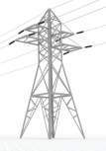
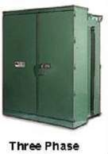
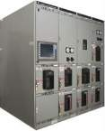
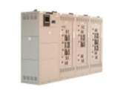
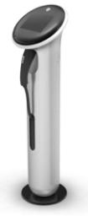



Old energy model is distributed power
Switchboards
And Panelboards
Utility Supply
Utility Transformer
Switchgear
General Purpose
Transformers
Sub-metering
Load Centers
GE WattStation

Slide 25




EV-Ready Transit Hubs will help drive our clean, active transportation future and these benefits:
  Mitigate Traffic Congestion
  Assure high quality of life, mobility, access
  to work, home and play
  Reduce emissions (burn) for clean air/ water
  Reduce energy consumption
  Increase and harness renewable energy
  Assure energy security and independence
  Fortify the grid
Notes:
319M people in U.S., 270M cars

Slide 26
Jill Sorensen
BEVI
Baltimore-Washington Electric Vehicle Initiative
jatsorensen@gmail.com
443-514-7122
www.MarylandEV.org

